Slide 1
WEEK 5
WEB DESIGN

Slide 2
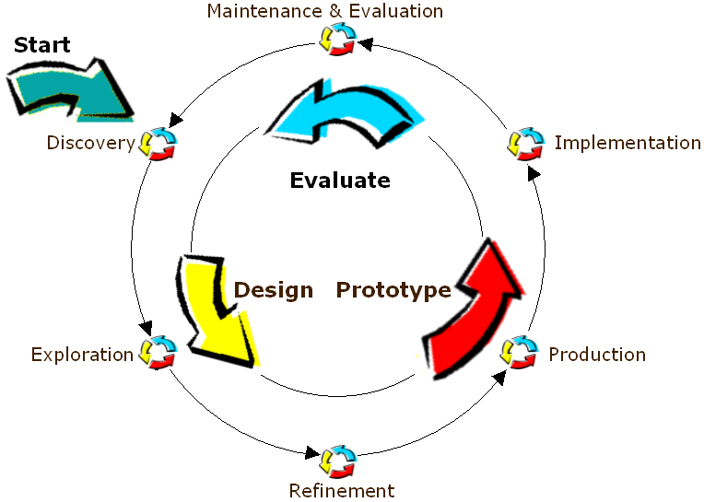
WEB DESIGN PROCESS
Discover the Purpose of Site
Discover the Audience
Discover the Task
Design Process
Validation

Slide 3

ANALYSIS AND DISCOVERY
Why analysis?
  To avoid the following scenarios…
    “Hey, you go ahead and start coding while I go out and ask the users what they want.”
The first steps of analysis:
  discover the purpose of your site.
  discover your target audience.
  discover the tasks that will be performed on the site.

Slide 4
DISCOVER THE PURPOSE OF THE SITE
There are four basic purposes of web sites:
  Purpose 1
The owners of these sites include corporations, small businesses, and non-profit organizations, and B2B sites
It can and should be about information, and it’s mostly about money.
Visitors’ goals :
  Researching products.
  Purchasing products.
  Obtaining service.
To make money
To disseminate
information
As a front end for
a business application
To stroke
someone’s ego

Slide 5
DISCOVER THE PURPOSE OF THE SITE
There are four basic purposes of web sites:
  Purpose 2
Corporate intranets, for publishing internal documents.
Universities, like Deakin.
Odds and ends of other sites: e-zines, health and hobby sites, fan sites, opinion sites
Visitors’ goals:
  To obtain information.
  To read or express opinions.
To make money
To disseminate
information
As a front end for
a business application
To stroke
someone’s ego

Slide 6
DISCOVER THE PURPOSE OF THE SITE
There are four basic purposes of web sites:
  Purpose 3
Intranets, extranets.
BUI/Browser User Interface as opposed to the traditional GUI/Graphic User Interface.
Like DSO, GMail, etc.
Visitors’ goals:
  To get a job done, with maximum efficiency and speed and minimum training, errors, and hassle.
  To share information.
To make money
To disseminate
information
As a front end for
a business application
To stroke
someone’s ego

Slide 7
DISCOVER THE PURPOSE OF THE SITE
There are four basic purposes of web sites:
  Purpose 4
Personal sites, many opinion sites, and odds and ends of other types.
It is always about ego.
  It can be about art, information, money
Visitors’ goals:
  Maybe only the creator visit it ☺
To make money
To disseminate
information
As a front end for
a business application
To stroke
someone’s ego

Slide 8

DISCOVER THE AUDIENCE
You need to have a precise definition of the target audience, the people you are trying to lure into your site.
  If your target audience is college students who are fans of, say, Kung-Fu, the site should look and function very differently than if the target audience is wealthy executives interested in buying luxury vehicles.

Slide 9
DISCOVER THE AUDIENCE
Create visitor profiles, including:
  Health, age, and gender:
    implications for font size, color issues, accessibility
  Expectations:
    theme, behavior, visitor interface structure
  Income level:
    who wants to or is able to buy what you are selling?
  User goals:
    what do they want to accomplish?
  Language:
    English only versus alternate versions
  Education:
    writing style, complexity
  Computer experience:
    tutorials, help files

Slide 10
DISCOVER THE TASK
Identify the tasks the visitors will attempt to complete, the order in which those tasks will be executed, and things that could be done to expedite the entire process called a scenario or use case:
  a set of possible sequences of interactions between systems and visitors in a particular environment and related to a particular goal.
Can document this in the form of a flow diagram for complex tasks.

Slide 11
DISCOVER THE TASK
Analyze how often and with what frequency they will perform each task.
  More frequent tasks should take priority.
  Less frequent tasks need more hand-holding.
What if the user doesn’t complete the task?
What to do if errors?

Slide 12
SUMMARY OF THE DISCOVERY PROCESS
Ask the clients what they need!
Client survey forms
  http://www.web-redesign.com/chapter3.html

Slide 13
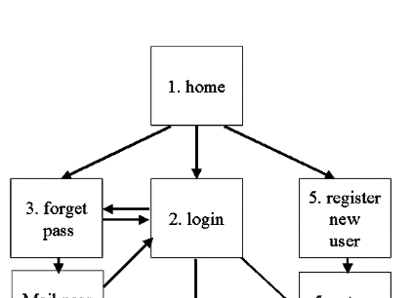
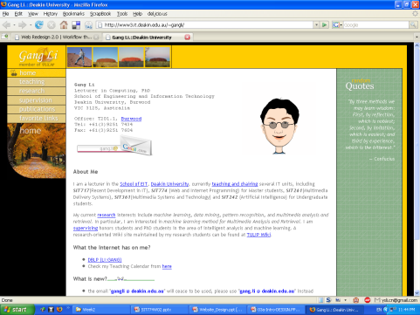
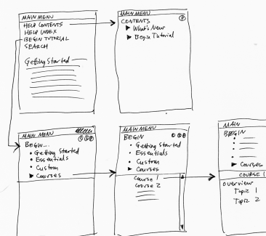
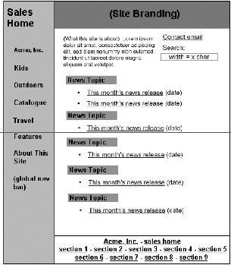
DESIGN AND PROTOTYPE
Designers create representations of sites at multiple levels of detail
Web sites are iteratively refined at all levels of detail
Site Maps
Storyboards
Schematics
Mock-ups

Slide 14

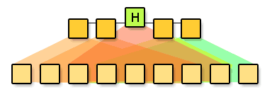
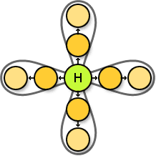
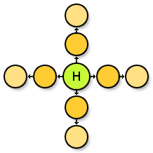
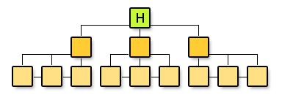
DESIGN AND PROTOTYPE:
SITE MAP AND NAVIGATION
Establish clear hierarchy of hypertext links
  Navigation design is a critical aspect of information architecture.
http://www.webdesignfromscratch.com

Slide 15
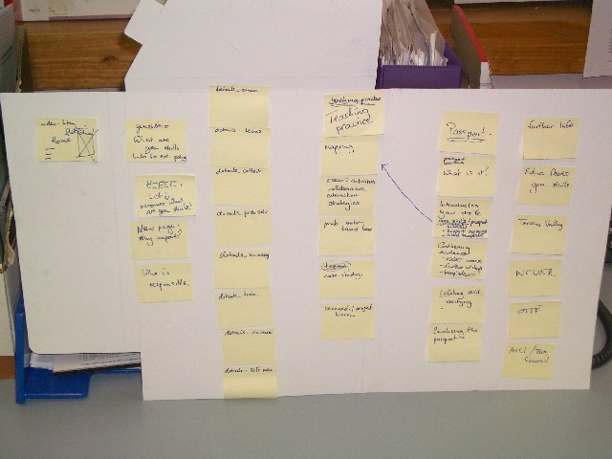
BROAD STORYBOARD

Slide 16
VALIDATE
Don’t be careless.
  Validate every page XHTML
    Don’t forget your CSS too.
    We will cover more about XHTML/CSS
    Lots of validation sites
    http://www.w3.org/QA/Tools/ and
    http://validator.w3.org/

Slide 17
GENERAL DESIGN PRINCIPLES
aim for simplicity and clarity
browsers and monitors determine site display
  know that your audience will have different size screens
visit other sites to help you determine what works and what doesn’t

Slide 18

NAVIGATION
navigation provides the method for moving through the information contained in the site.
plan it carefully
it should be clear and consistent throughout the site
don’t have links to empty pages or pages under construction
use consistent and intuitive elements or buttons
This is cute but doesn’t mean anything in terms of navigation!
This arrow clearly communicates to the user – click to move to the top of the page.

Slide 19
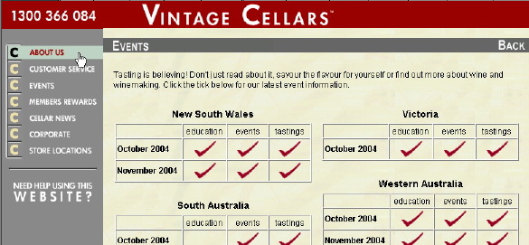
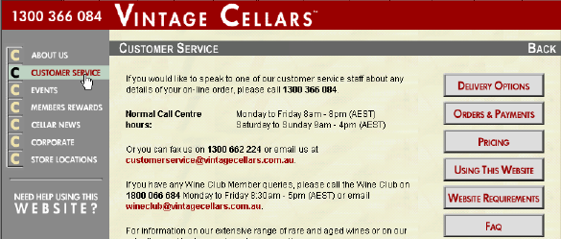
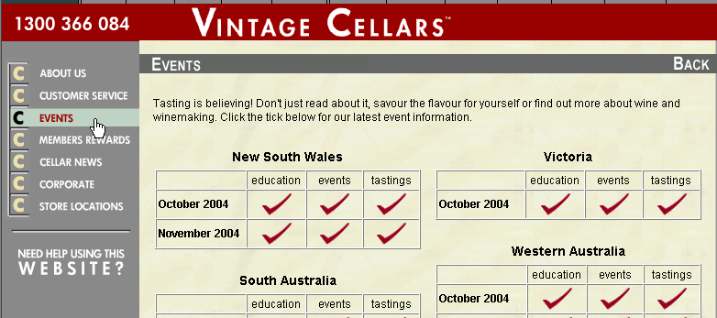
The navigation remains the same regardless of the page you are viewing.

Slide 20
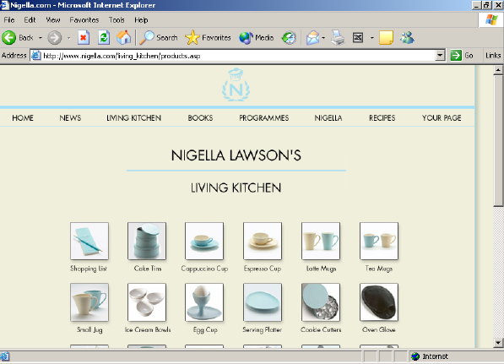
WEB PAGE FEATURES - IMAGES
Images
GIF, JPEG, PNG
Notes:
File Format
GIF is most commonly used format (graphic interchange format) Developed by CompuServe. Platform independent.
Limited color 256 - used for graphics requiring fewer colors eg logos, clip art, icons. Allows for interlacing - appears in layers, each layer adding more clarity.
Allows for transparency - background color of the page will show through. Can create animations.
JPEG Joint Photographic Experts Group - best format for photographs - can contain 16.7 million colors
PNG developed because of royalties demanded to use GIF files. Will eventually replace GIF and JPEG. Can be 256 color or 16.7 million. Browsers need to be updated.

Slide 21

GIF IMAGES
Displays 256 colors
One color can be made transparent
Can be animated
Use for icons, logos, drawings

Slide 22
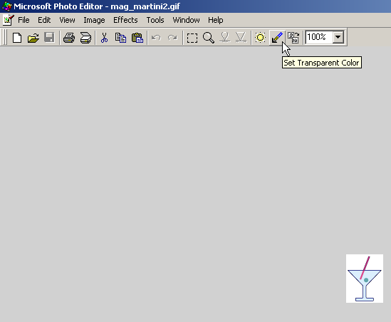


Before transparency
After transparency

Slide 23
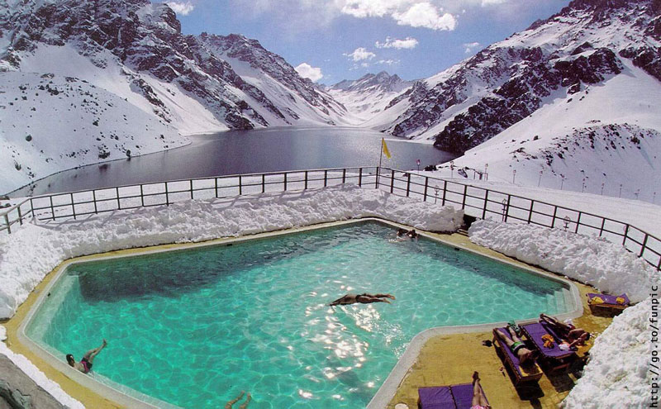
JPEG IMAGES
Display 16.7 million colors
Use for photographs
PNG is a newer file format that can display up to 16.7 million colors. Cannot be displayed on older browsers.

Slide 24
SOURCING IMAGES
Use digital camera
  change pixels of images to 640 x 480 for web pages
Scan images
Use drawing packages eg Fireworks
Free clipart sites (read the fine print)
  try www.iconbazaar.com for good arrows and other icons

Slide 25
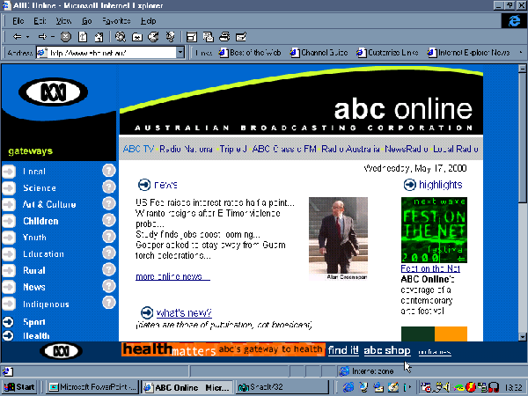
HYPERLINKS
Hyperlinks
images, icons, text

Slide 26
HYPERLINKS CAN BE MADE TO:
other pages within the web site
outside web sites
different parts of the same page eg bottom of page to the top
email addresses

Slide 27
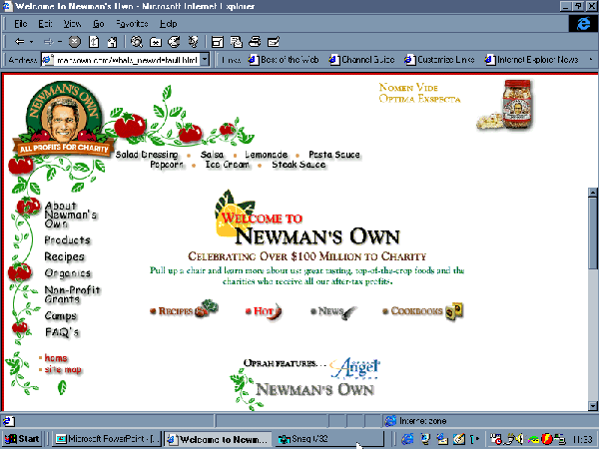
WEB PAGE FEATURES - FRAMES
Static
Frames
More than one page is loaded on the screen at one time.
Changing

Slide 28
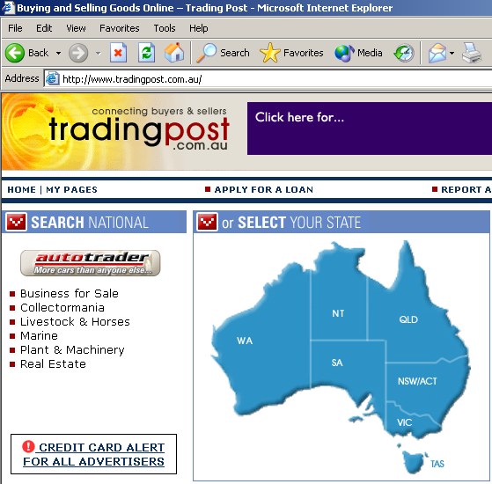
WEB PAGE FEATURES - IMAGE MAPS
One graphic with several clickable links.

Slide 29
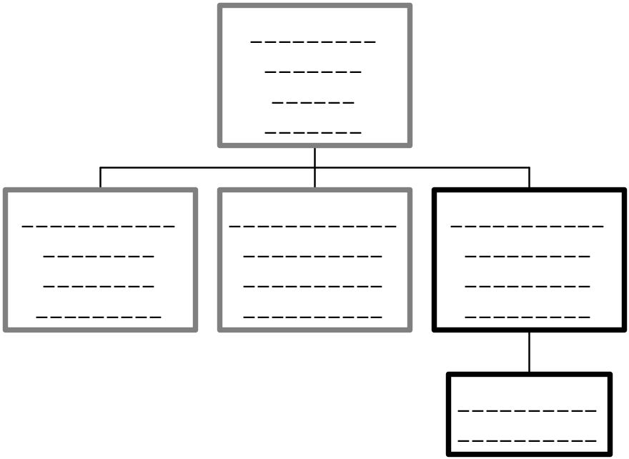
SITE ORGANISATION
Hierarchical
Linear

Slide 30
WRITING
No-one has time to waste on bad pages.
Clear and concise.
Organise pages for quick scanning.
  use headings
  use lists
  use list menus
Proofread

Slide 31
CONTENT DESIGN
make content relevant to the intended audience
enable them to drill down easily
make sure the content is valid, accurate and timely
group information into small units
place like things together
provide an accurate label for each section

Slide 32
LAYOUT DESIGN
try to keep the choices simple
don’t ever make users scroll horizontally
note file size so it doesn’t become too slow to download
use white space
  text is better centred on a page rather than having to move the eyes from the left margin to the right margin

Slide 33
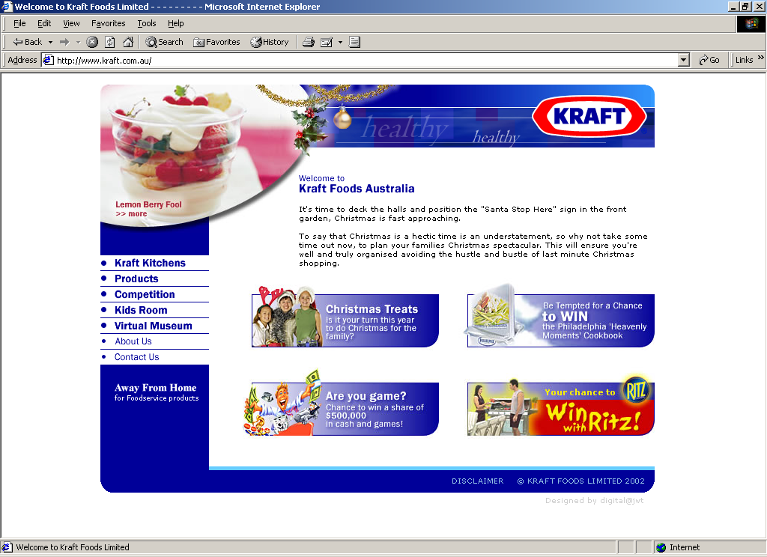
Text is placed in one small area so that users do not have to read all the way from left to right margins.

Slide 34
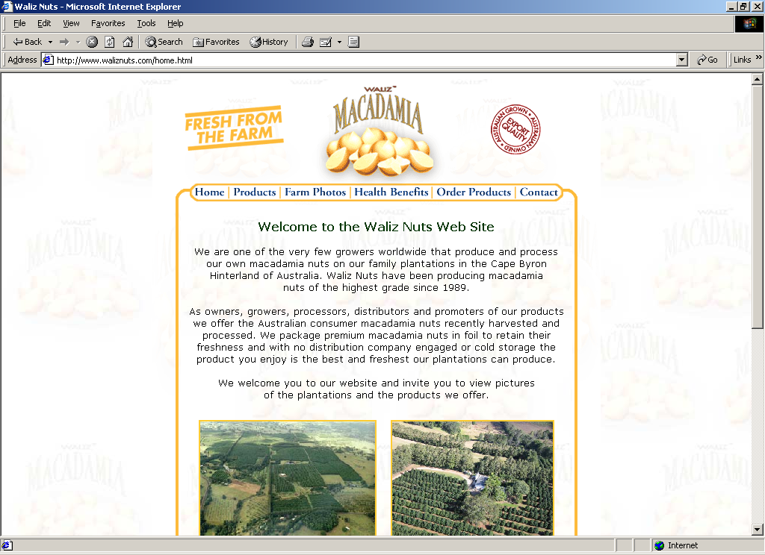
And again…

Slide 35
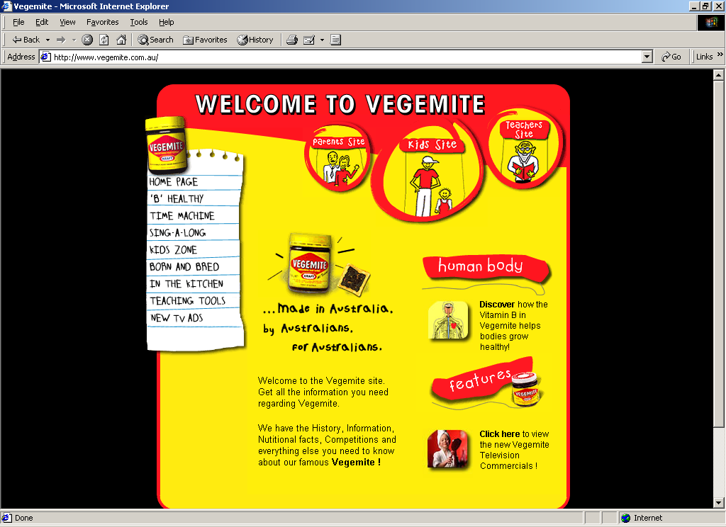
And again…

Slide 36
LAYOUT CONT
use images consistently
  keep a consistent style and background to all pages in the site
use consistent layout
  font sizes, headings and paragraph alignments.
avoid typing in all capitals
avoid too much bold or italics
don’t use underlining as a highlight
Avoid fancy fonts – users might not have them installed on their computer. Stick to Verdana, Arial or Times New Roman.

Slide 37

SERIF OR SANS-SERIF?

Slide 38
COLOR, GRAPHICS & ANIMATION
the arrangement of text and graphical elements will directly affect the importance of the site
each graphic must add value to communication
graphics intensive pages decrease performance

Slide 39
COLOR, ETC CONT
Using background images & color
  use carefully, patterns make text very difficult to read.
  dark text on a light background is best
  black backgrounds with white text will not print

Slide 40
Hard to read
Easier to read

Slide 41
TESTING
every web site should be “piloted”
  is the page layout clear
  are the pages consistent
  do pages support the information needs of users
  test on different browsers
  PROOFREAD for errrors!

Slide 42
PUBLICISING YOUR SITE
word of mouth
follow a link from another site
find your site listed in a search engine
announce site on a news group
business cards, letterheads, brochures and advertisements

Slide 43
SEARCH ENGINES
Register
Hints for search engines
  keywords in <TITLE> tag
  keywords in first few lines of web page
  keywords repeated within pages
  keywords in <META> tags
    <META NAME=“keywords” CONTENT=“keyword1” “keyword2” ... >
    Meta tags go in the <head> after the <title>

Slide 44
A META EXAMPLE
<!DOCTYPE HTML PUBLIC "-//W3C//DTD HTML 4.01 Transitional//EN">
<HTML>
<HEAD>
<TITLE>Deakin University</TITLE>
<META name="Title" content="Deakin University" />
<META http-equiv="Content-Type" content="text/html; charset=iso-8859-1" />
<META name="Author" content="ITS Web Team" />
<META name="Publisher" content="Deakin University" />
<META name="keywords" content="deakin, deakin university, online learning, distance education, australian university, deakin australia, deakin prime, deakin international, leading research" />
<META name="Date" content="2003" />
<META name="Terminator" content="info@deakin.edu.au" />
<META http-equiv="expires" content="2005" />
<META http-equiv="Content-Language" content="en-Au" />
<META name="Location" content="http://www.deakin.edu.au" />
<META name="Scheme" content="IMS v1.0/IeeeLOM v3.05" />

Slide 45
ACCESSIBILITY ISSUES
Use “alt” attribute for all images
Use meaningful titles
Don’t use “Click here”
Use colors carefully
Avoid frames

Slide 46
IN CONCLUSION THE RULES ARE:
make it simple (easy to navigate)
make it fast to download
understand your users
minimalist navigation system
content should be short with lots of bullets – users scan content to make it easy for them

